Slide 1
HR Dashboard

Slide 2





TEAM MEMBERS
Marwa
Shama
Sarah
saney
Mona
omara
Sama
Mohamed
Yasmeen
elewa

Slide 3
AGENDA
1
Introduction
2
Objectives
3
Analysis Steps
4
Data and Business Questions
5
Data Cleaning and Transformation
6
Overview Insights
7
Summary
8
Recommendation

Slide 4
Introduction
What is Human Resources (HR)? Human Resources (HR) focuses on managing an organization’s most valuable asset: its employees. HR professionals ensure employees have the necessary resources for their tasks and foster a positive work environment.
They handle various responsibilities, from recruiting and compliance to benefits and training

Slide 5
Objectives
When setting up an HR data analysis project, it's crucial to
define objectives that align with your organization's goals.
Common objectives include:
Improve Recruitment Processes: Identify effective channels and reduce time-to-hire.
Enhance Employee Retention: Understand turnover factors and develop retention strategies.
Boost Employee Engagement: Measure engagement levels and implement improvement initiatives.
Optimize Workforce Planning: Forecast hiring needs and identify skill gaps.
Increase Productivity: Identify high-performing employees and success factors.
Support Diversity and Inclusion: Monitor diversity metrics and promote inclusivity.

Slide 6

Analysis Steps
Data Collection
Analysis and Brain Storming
Data Cleaning and Transformation
Data Model
Insights and Visualizations

Slide 7
Analysis and Brain storming
General
Count of Job Roles
Count of The Hiring Employee Annually
Attrition Analysis
What Is the Impact of Salary On Attrition
How Does Working Over Time Leads to Attrition
Salary Insights
Sum of Salary Per Each Department
What Is the Salary Distribution Across Different Education Levels
Performance and Satisfaction
What is the Satisfaction Level?
What is the Rating of employee?

Slide 8
Data Cleaning and Transformation
1. Data Type Adjustments:
Modified data types according to the
appropriate usage for each column in the
Employee and PerformanceRating tables.
2. Readability Enhancements:
• Transformed binary columns with (0,1)
values into more understandable
options like Yes/No.
• This transformation was applied to:
• OverTime
• Attrition
3. DAX Calculations for Binning:
Created three new columns using DAX
for effective data segmentation:
• Salary Bins
• Distance Bins
• Age Bins

Slide 9
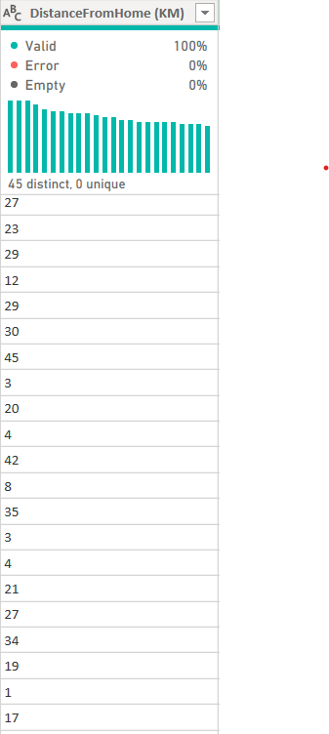
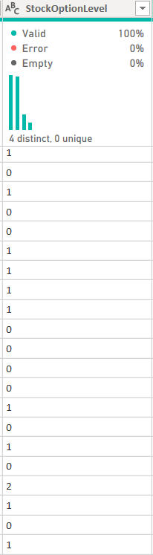
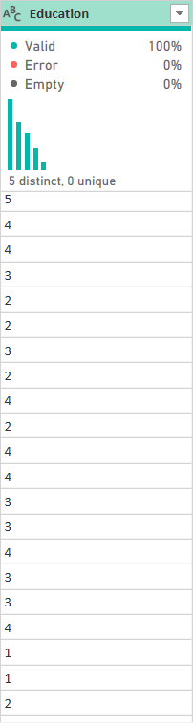
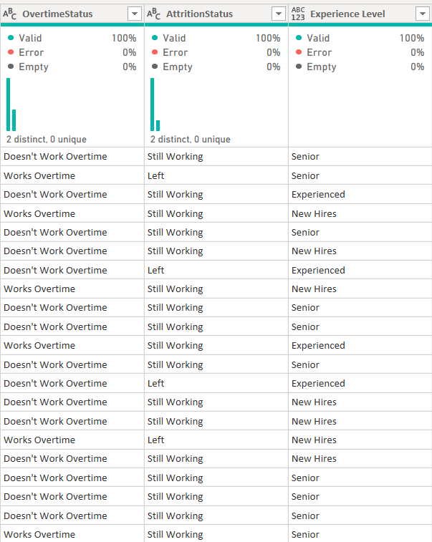
Data Cleaning and Transformation

Slide 10
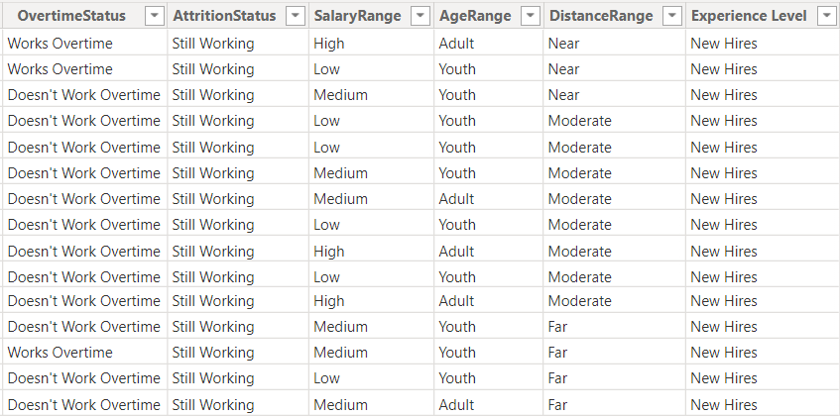
Data Cleaning and Transformation
DistanceRange =
SWITCH(
TRUE(),
'Employee'[DistanceFromHome (KM)] < 5, "Near",
'Employee'[DistanceFromHome (KM)] >= 5 && 'Employee'[DistanceFromHome (KM)] < 15, "Moderate",
'Employee'[DistanceFromHome (KM)] >= 15, "Far",
"Unknown"
)
AgeRange = SWITCH(
TRUE(),
'Employee'[Age] < 25, "Youth",
'Employee'[Age] >= 25 && 'Employee'[Age] < 50, "Adult",
'Employee'[Age] >= 50, "Senior",
"Unknown"
)
SalaryRange =
SWITCH(
TRUE(),
'Employee'[Salary] < 50000, "Low",
'Employee'[Salary] >= 50000 && 'Employee'[Salary] < 100000, "Medium",
'Employee'[Salary] >= 100000, "High",
"Other"
)

Slide 11
Data Modeling
1. Simple Two-Table Model:
Established a one-to-many relationship between the EmployeeID in the
Employee table and the corresponding field in the PerformanceRating table.
2. Efficiency in Model Design:
Even with just two tables, the model enables seamless data integration and analysis,
allowing for:
• Linking employee details with their performance metrics.
• Efficient querying and visualization across both datasets.

Slide 12
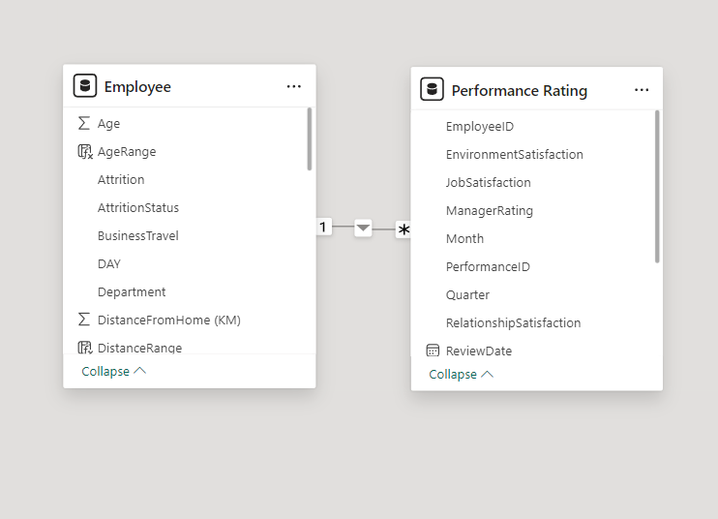
Data Modeling

Slide 13
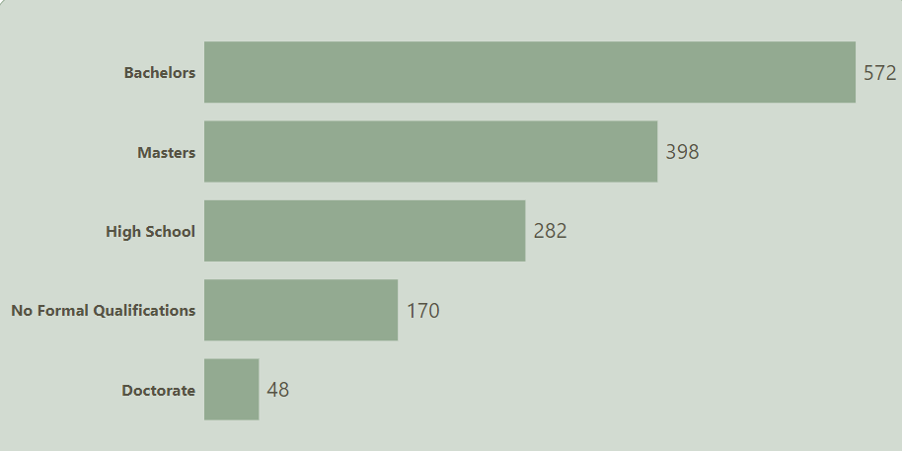
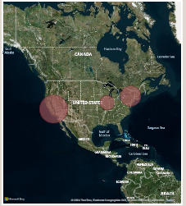
General Insights:
According to the key performance measures we have reached:
Education
The bar graph shows that most employees have a college education, with fewer employees holding advanced degrees.
Geographical Distribution
The map displays the concentration of employees in different regions, highlighting variations in geographical distribution.

Slide 14
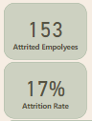
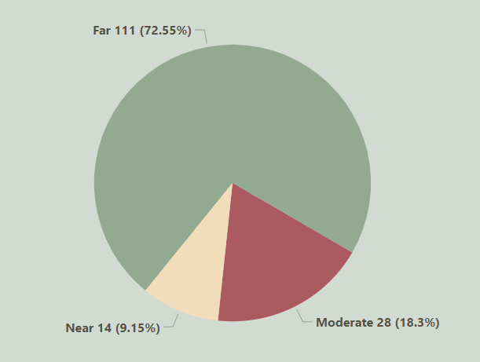
Attrition Insights:
According to the key performance measures we have reached:
Attrition
153 employees left the company, which represents 17% of the total workforce
Attrition
72% of the employees who left the company lived far from their workplace.

Slide 15
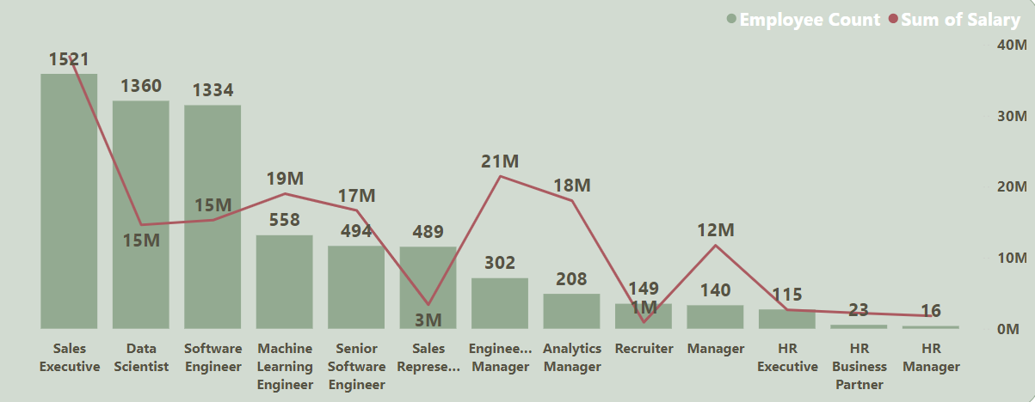
Salary Insights:
The dual-axis bar and line graph you provided shows the distribution of employee count and total salary across various job titles. Here are some key insights:
Sales Executives: Highest employee count (1521) and highest total salary (around 350M), Data Scientists: Second highest employee count (1360) and total salary (close to 300M).

Slide 16

Summary
Total Employees Left: 153 (17% of the total workforce).
Distance Factor: 72% of the employees who left lived far from their workplace.
Sales Department: The highest turnover rate is observed in the sales department.
Overtime Factor: 25% of the employees who work overtime end up leaving the company.

Slide 17

Recommendation
Remote Work Options: Implement remote work policies to allow employees to work from home, reducing the need for long commutes.
Flexible Working Hours: Offer flexible working hours to help employees avoid peak traffic times, making their commutes more manageable.
Transportation Benefits: Provide transportation allowances or company-sponsored shuttle services to make commuting easier for employees who live far away.
Relocation Assistance: Offer relocation packages to employees willing to move closer to the workplace.
Employee Feedback: Conduct surveys or focus groups to gather feedback from employees about their commuting experiences and other factors that might influence their decision to stay or leave.

Slide 18
thank you

